Slide 1
GEOG 392/676 GIS Programing Lab6
Zhenlei Song, Ph.D Student
Department of Geography
Email: songzl@tamu.edu
Office: CSA 301F

Slide 2
Lab 6 Tasks
Implement an ArcGIS Pro Toolbox that:
Re-render the “Structures” layer using “UniqueValueRenderer”.
Re-render the “Trees” layer to “GraduatedColorsRenderer”.
Supports “Step” progressor.

Slide 3
Important Notes
Data Source
Use the “Campus.gdb” from Lab4/5. Load it in an ArcGIS Pro project manually. Use this project as the input of your code.
Tutorial & Reading material
https://github.com/TAMUCIDI/GEOG-392-GIS-Programming/blob/main/Labs/Lab05/Lab05-pre02.md

Slide 4
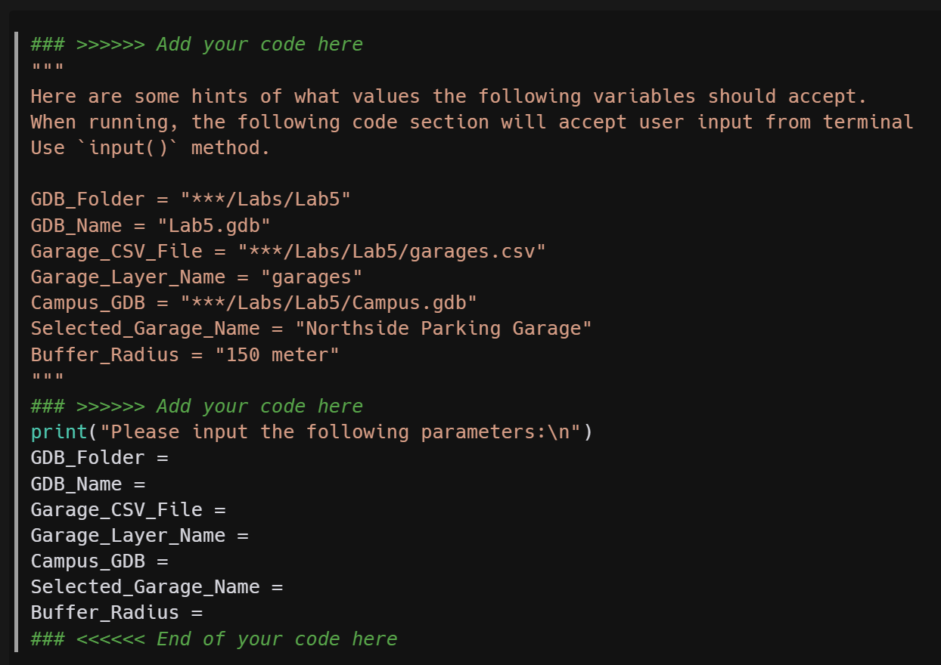
Part 1. ArcPy Tool
Step 1. Accept Parameters from User Input
Use `input()` func to accept user input from terminal.
Only `garage_name` and `buffer_radius` are required to be accepted from user input.
The rest items are optional, that means you can assign them with fixed values like in Lab4.

Slide 5
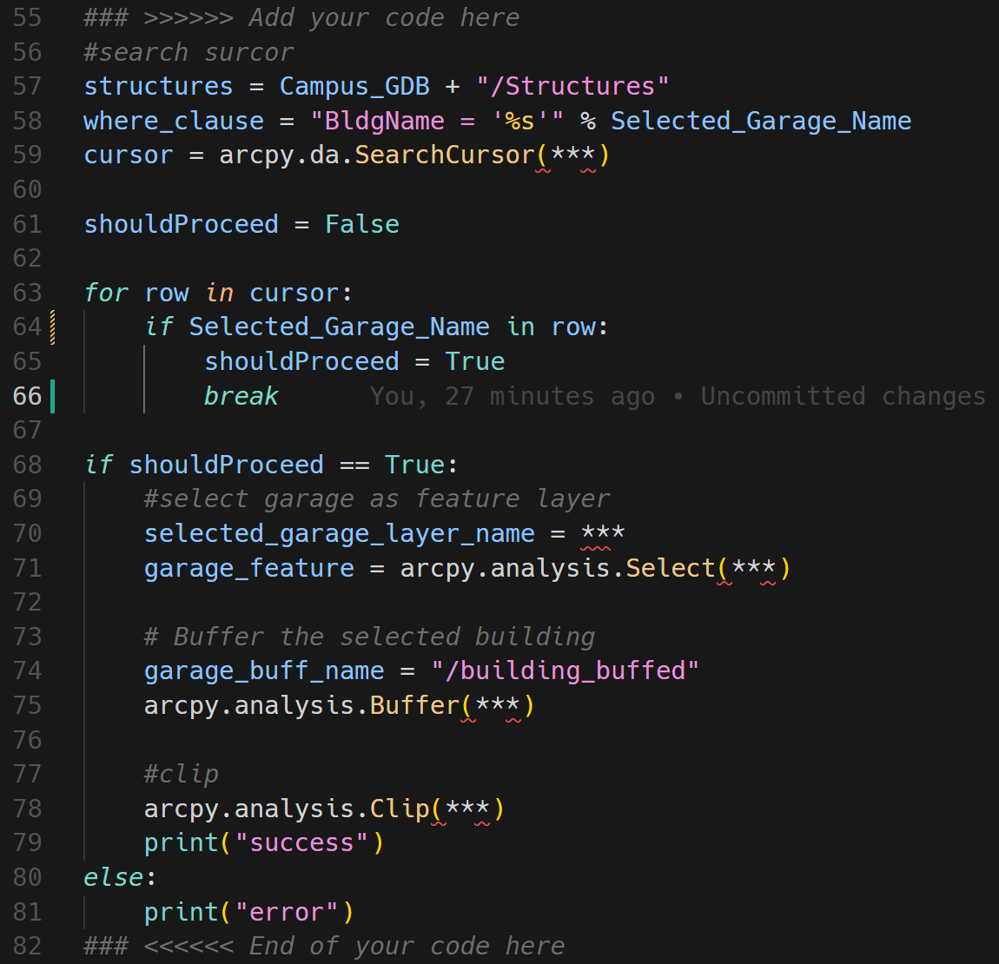
Part 1. ArcPy Tool
Step 2. Determine Whether the selected building exists
Use `arcpy.da.SearchCursor` func to create a search cursor.
Use a loop to match rows in a cursor.
Within each loop, determine if the search cursor found the value that user entered.
If so, proceed to the next step.
If not, exit with error message.

Slide 6
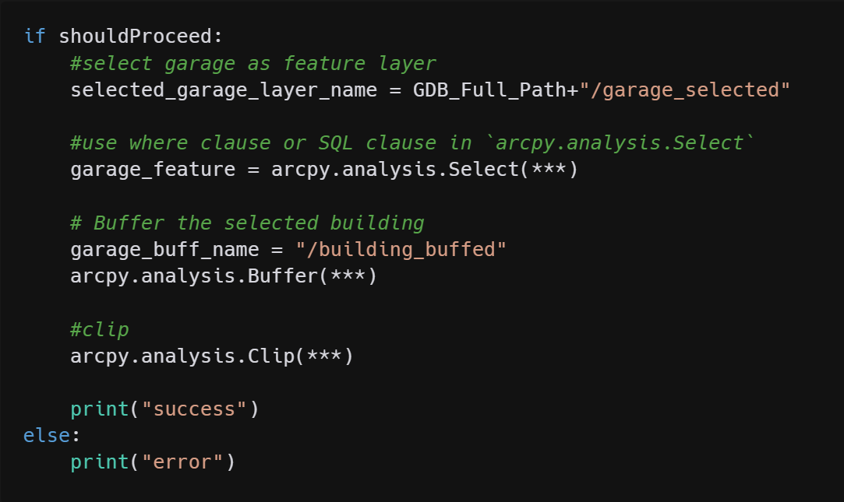
Part 1. ArcPy Tool
Step 3. Buffer & Clip
Select the garage with the name entered.
Buffer on the selected sub-feature class.
Clip the structures on the selected garage buffer.

Slide 7
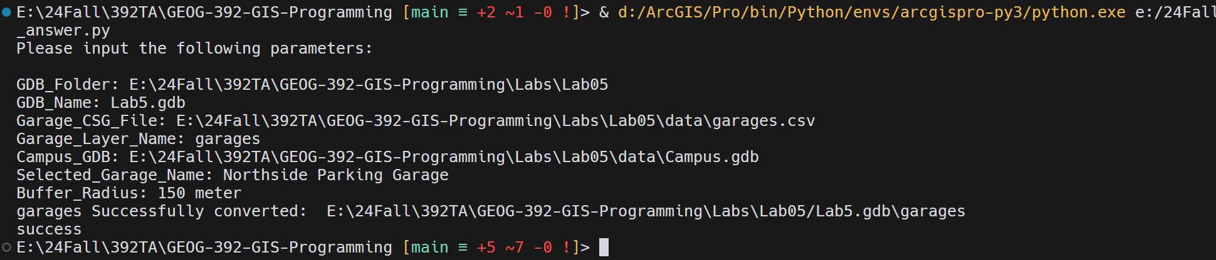
Part 1. ArcPy Tool
Result

Slide 8
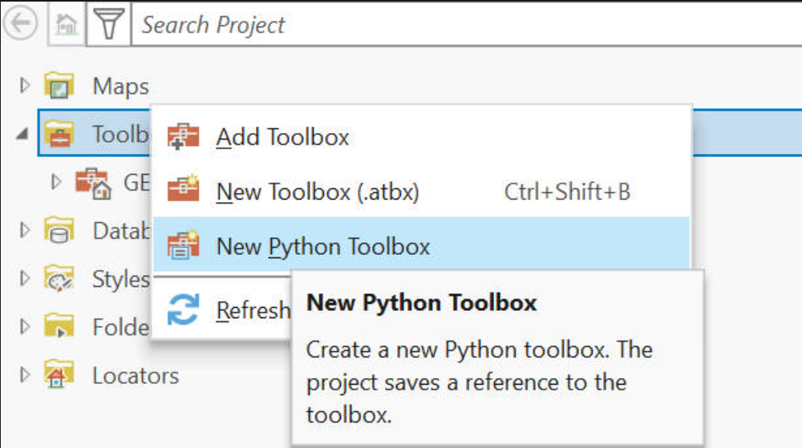
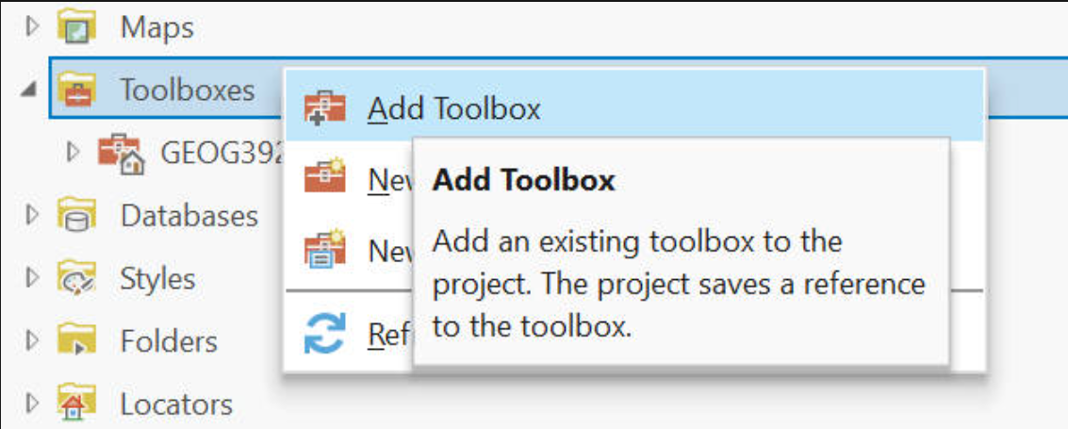
Part 2. ArcPy Toolbox
Step 1. Create or Add a toolbox
Notes:
New python toolbox will ask you to generate a new XXX.pyt file with default templates.
Add toolbox can import your own XXX.pyt.

Slide 9
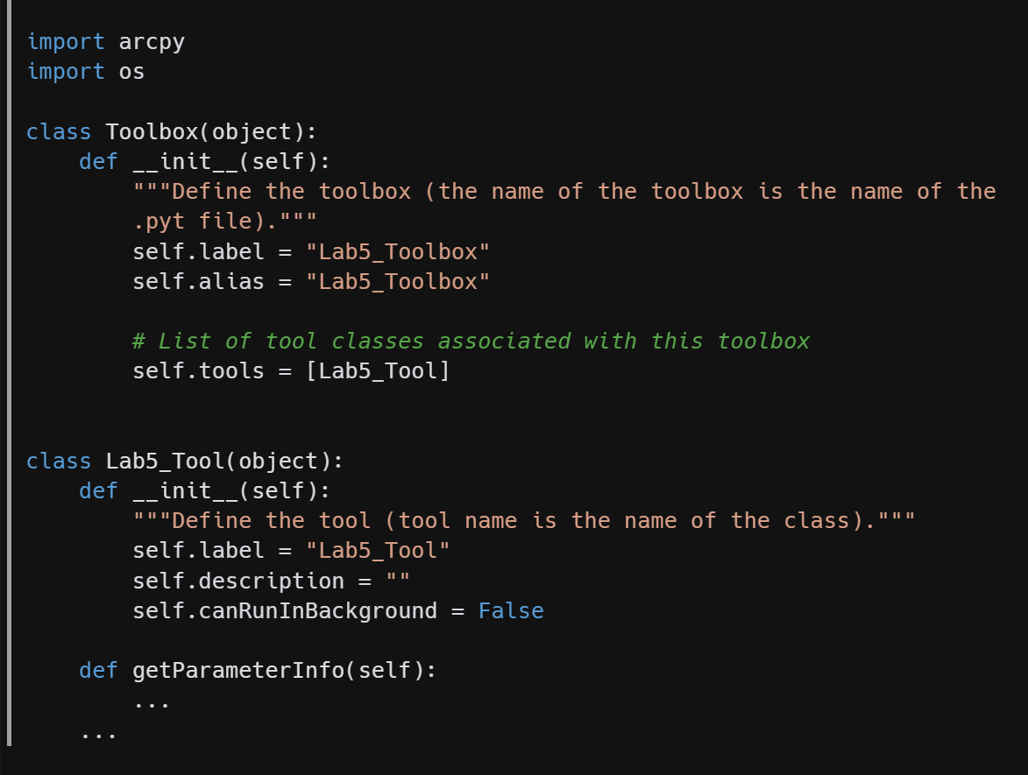
Part 2. ArcPy Toolbox
Step 2. Toolbox Class
2 classes: `Toolbox` and `Tool`
Toolbox:
In __init__ func, it needs to declare the name of the `tool` class in the `self.tools`.
Tool:
Next page
Notes:
In a XXX.pyt file, there need to be 2 classes at least.
The toolbox class.
The Tool class.
In the init function of toolbox class, it needs to declare the name of the tool class like we do here in the template.

Slide 10
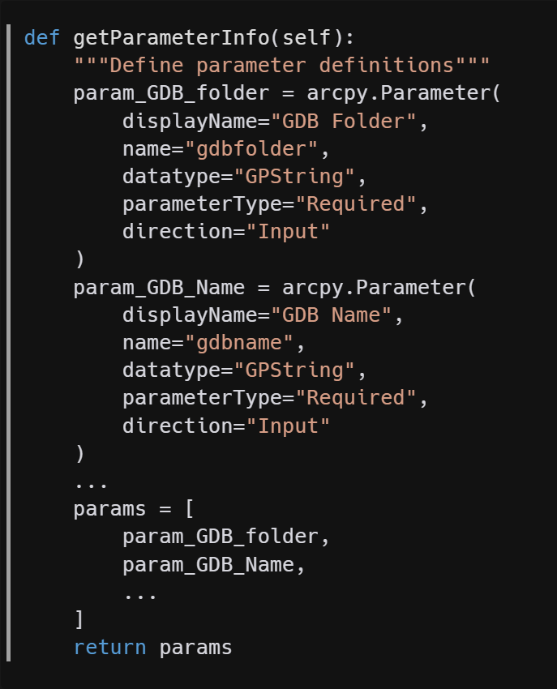
Part 2. ArcPy Toolbox
Step 3-1. Tool Class – getParameter()
3 functions are required in the `Tool` class:
`__init__()`
`getParameter()`
`execute()`
Use `arcpy.Parameter()` method in the `getParameterInfo()`.
`getParameterInfo()`. API Link: https://pro.arcgis.com/en/pro-app/latest/arcpy/geoprocessing_and_python/defining-parameter-data-types-in-a-python-toolbox.htm
This doc is very very very very important. Be careful with the parameterType
Notes:
I only show 2 parameters in the screenshot: GDB Folder and GDB name.
Please remember, only garage name and buffer radius are required parameters.
You can choose to add more parameters here.
But please make sure you set the parameter settings correctly.
For example, buffer radius data’s parameter type could be float. Look through the DOC to find out how to set it up.

Slide 11
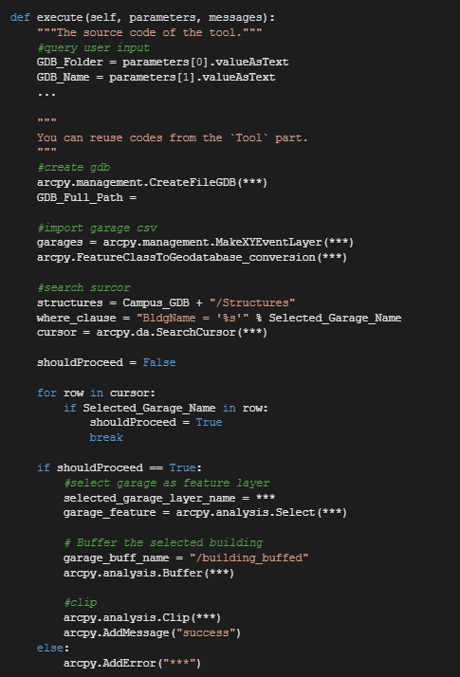
Part 2. ArcPy Toolbox
Step 3-2. Tool Class – execute()
Accept values from parameters in the getParameter() func.
Re-use most codes from Part1 to do the select, buffer, and clip operations.
Except for the messages. Instead of use `print()`, use `arcpy.AddMessage()` and `arcpy.AddError()` here.

Slide 12
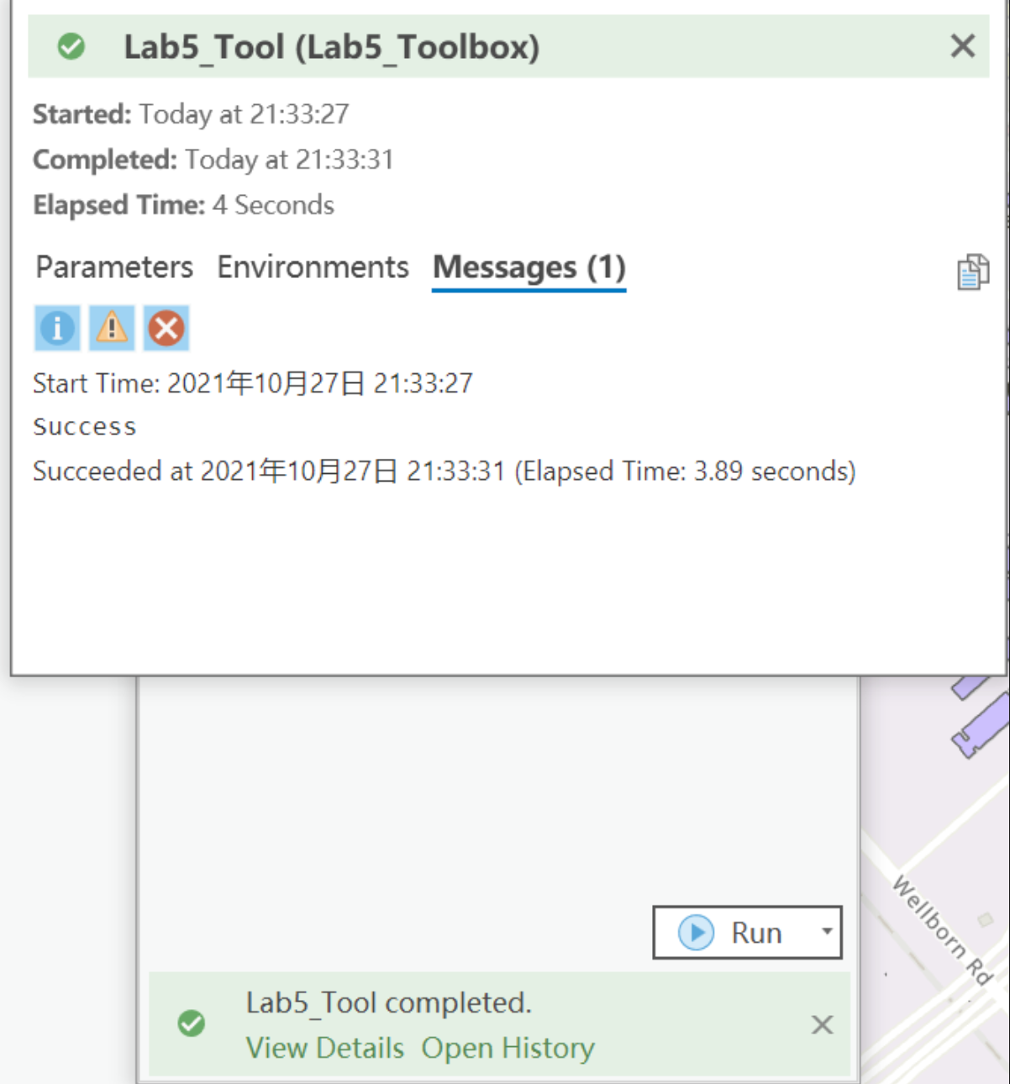
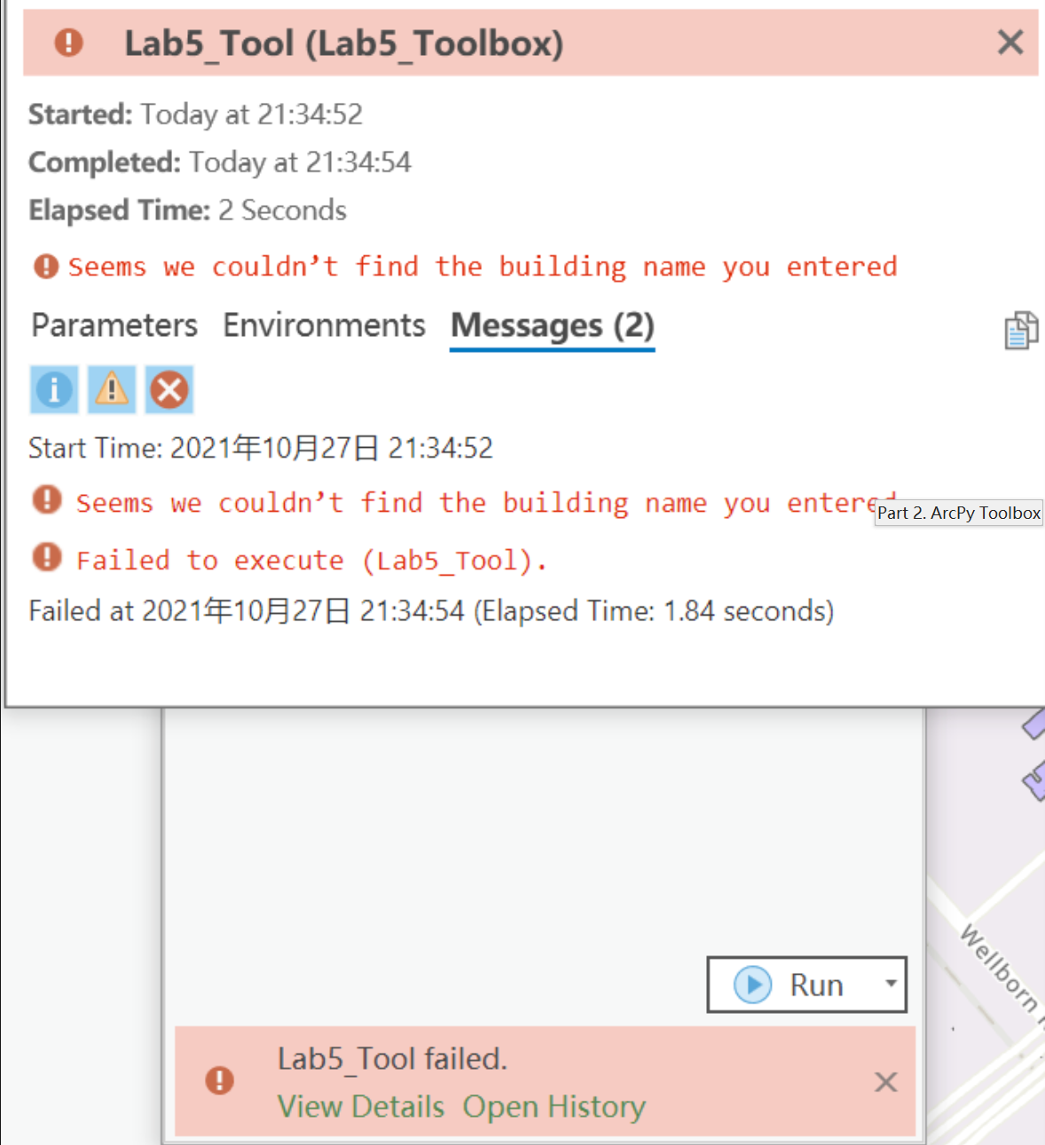
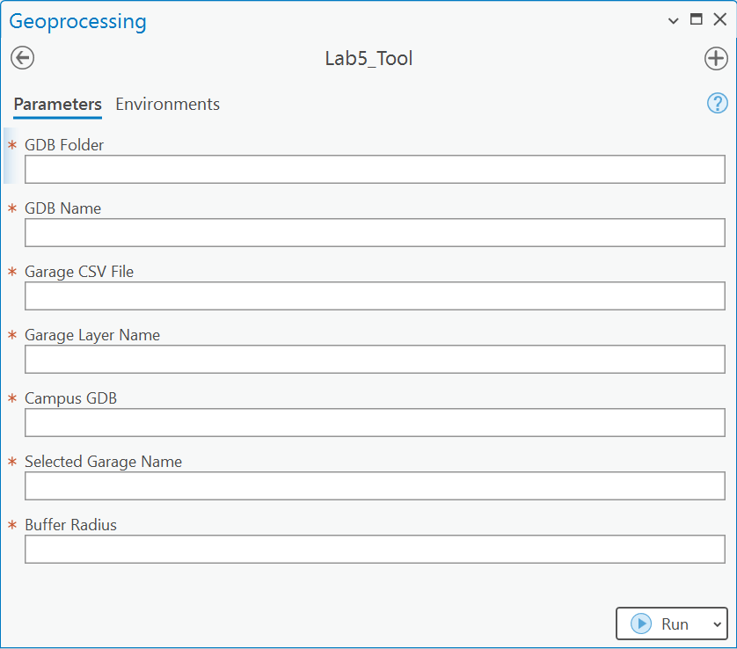
Part 2. ArcPy Toolbox
Results

Slide 13
Submission
A PDF file in 2 parts:
Tool Part
A screenshot of all your codes.
A screenshot of the running result in the terminal.
A screenshot of the output feature in ArcGIS Pro.
Toolbox Part
A screenshot of all your codes.
A screenshot of the toolbox interface in ArcGIS Pro.
Screenshots of the running details of the toolbox. Both the success and the error messages.
And your Github Link

Slide 14
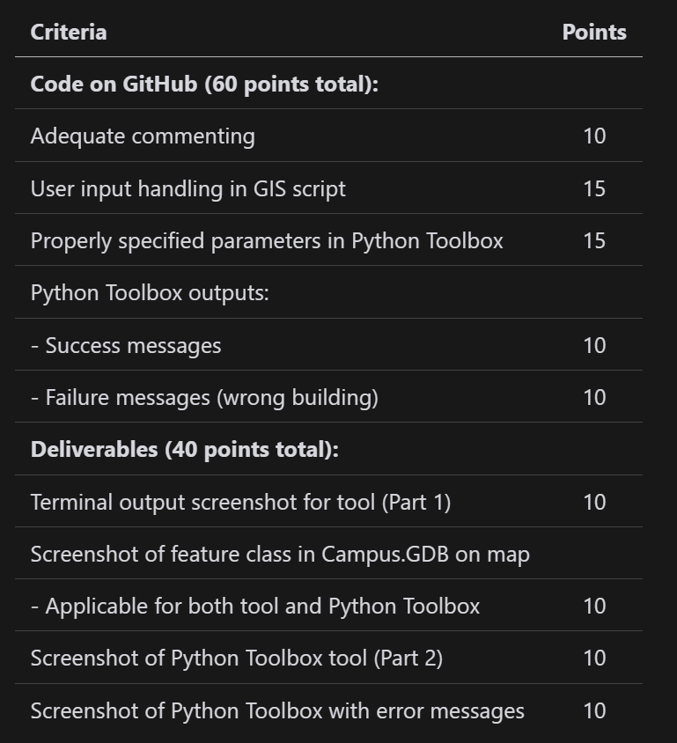
Grading Rule

Slide 15
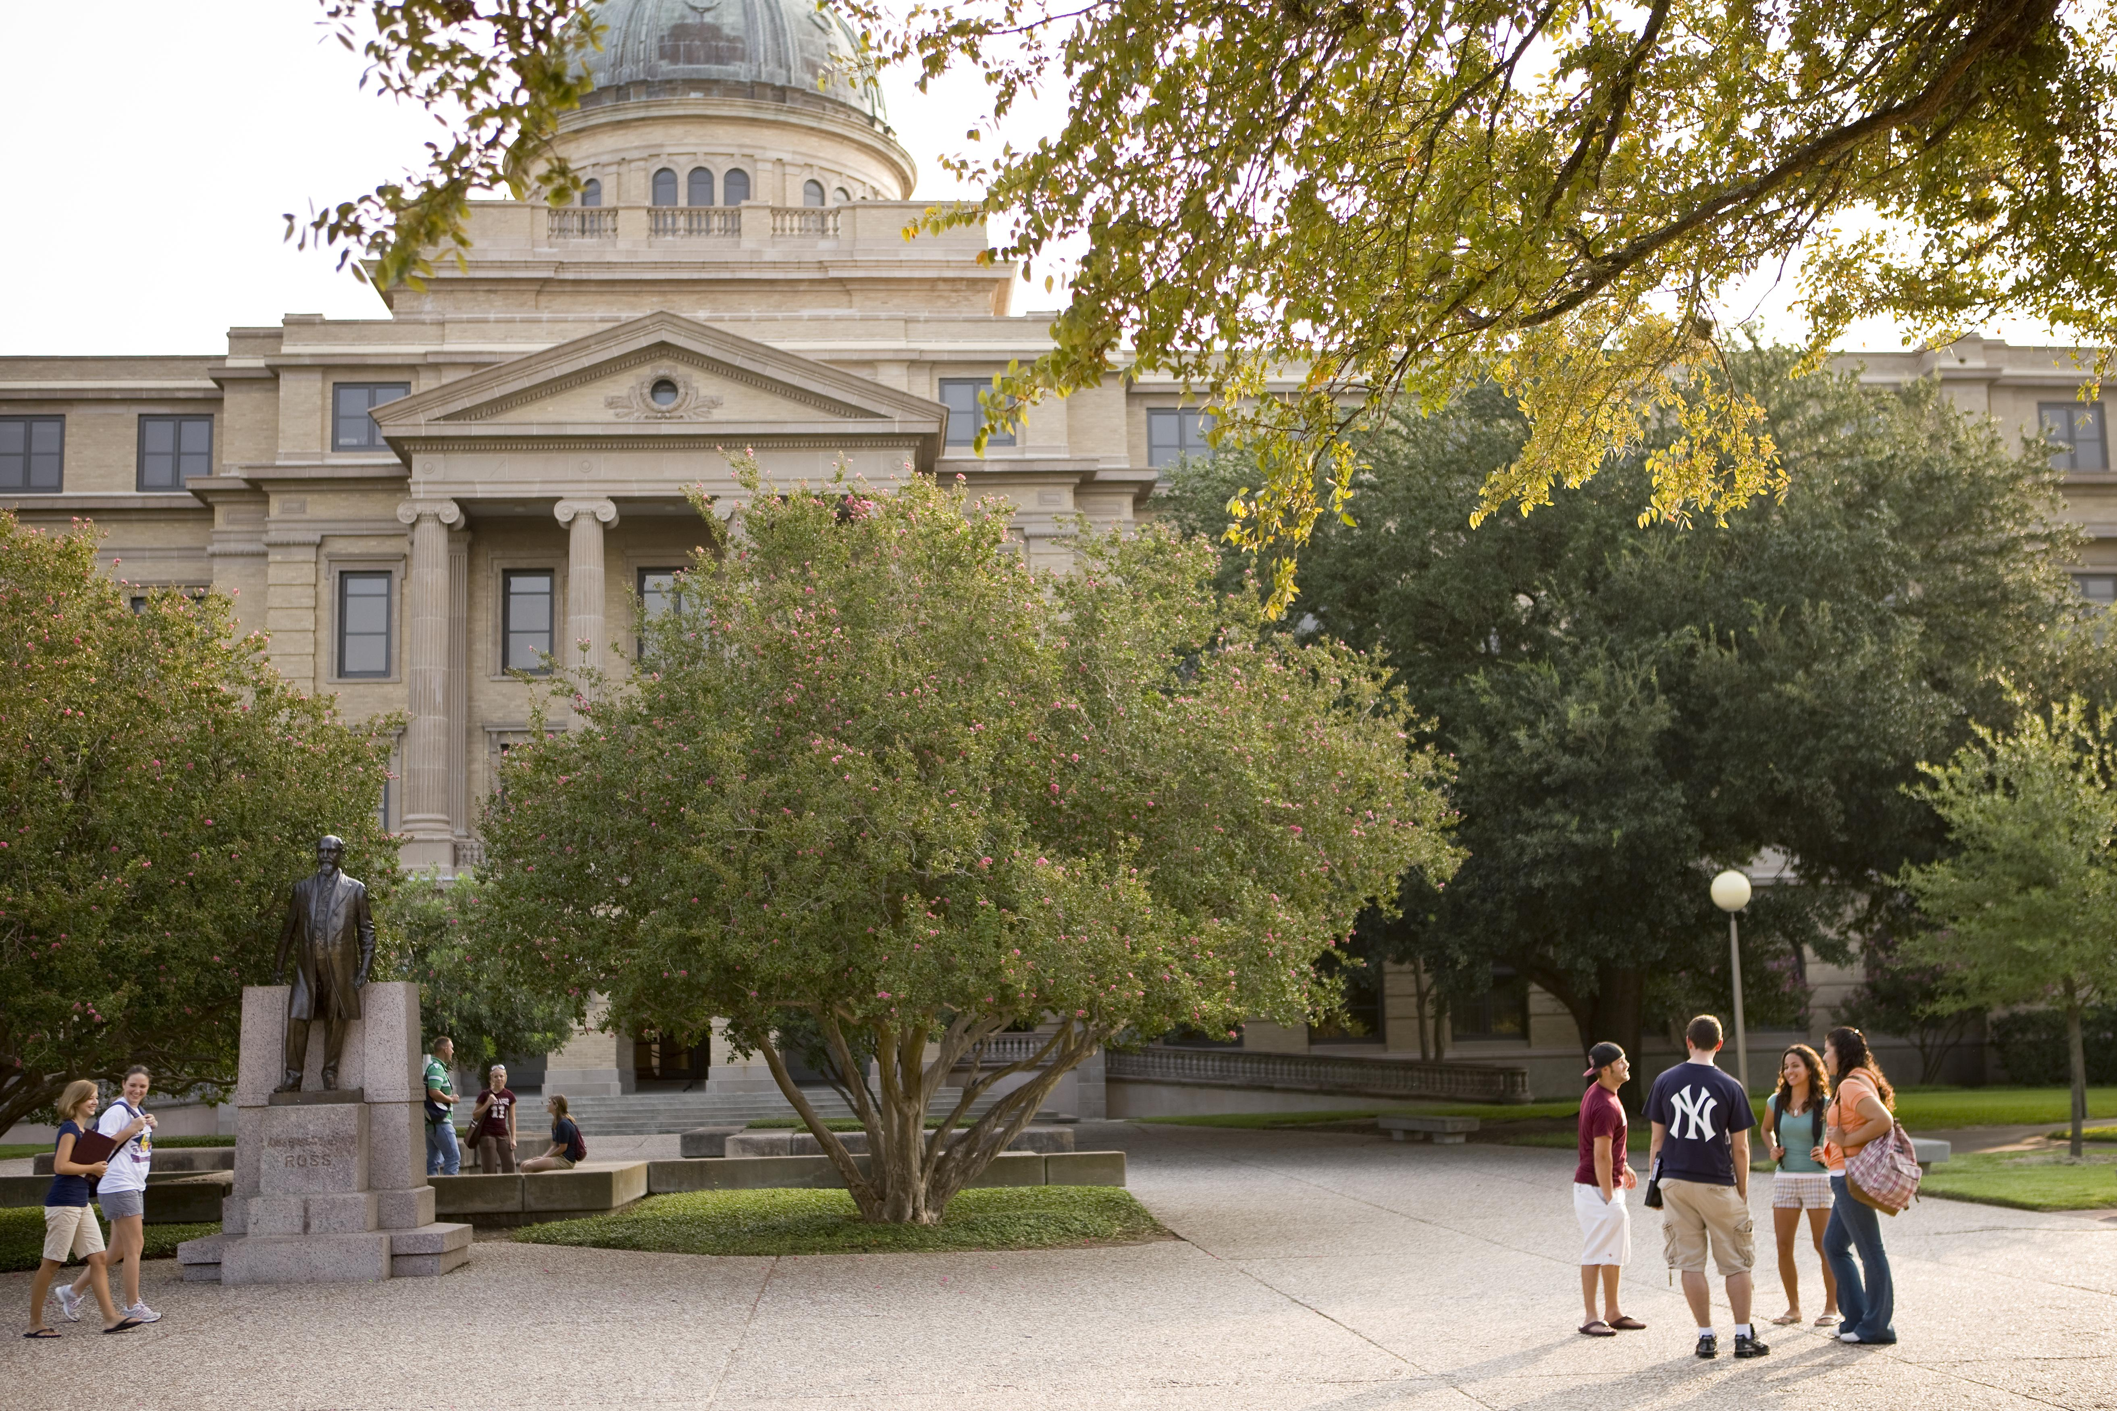
Additional Resources
Useful Links
`Input()`
`arcpy.da.SearchCursor`
Arcgis parameter Docs
`arcpy.AddMessage`
VS Code Plugins
Python
Pylance
Python Debugger
Gitlens

Slide 16
The End

